Slide 1


NODE.JS GLOBAL
Authentication. Validation. Security
FEBRUARY, 2019

Slide 2
AGENDA
Validation with AJV
Authentication with Passport.js
JSON Web Tokens (JWT)
Security

Slide 3
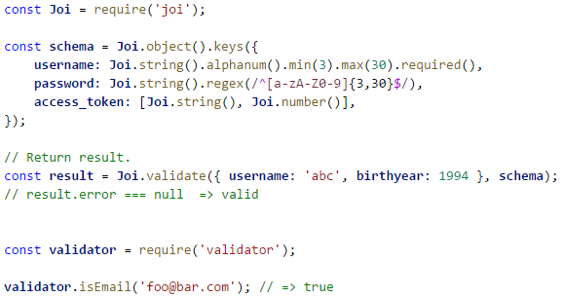
VALIDATION
By schema
By chaining calls (fluent interface)
String validation

Slide 4
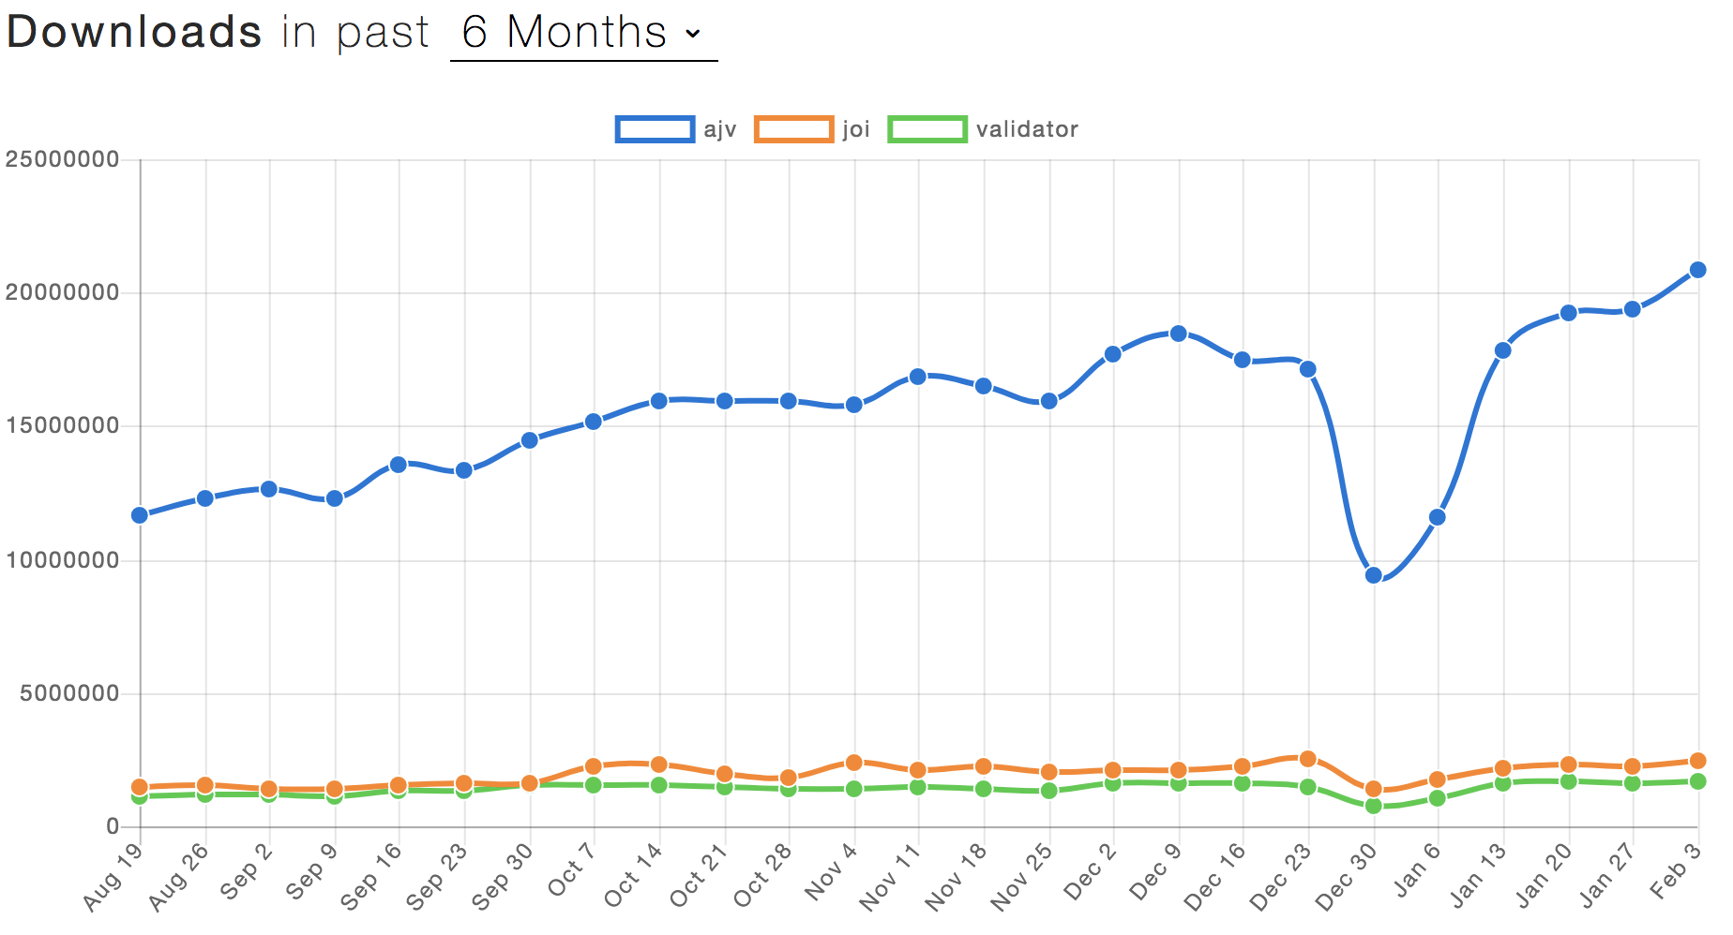
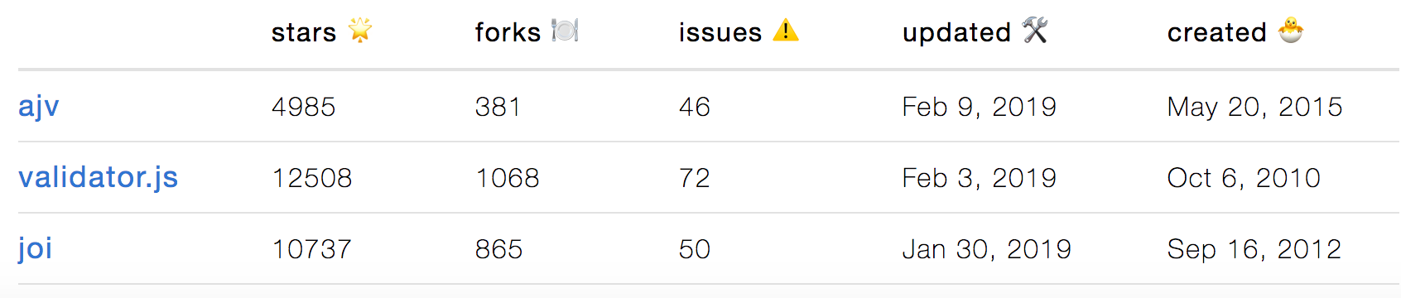
VALIDATION LIBRARIES
https://github.com/epoberezkin/ajv ★ 4 985
https://github.com/hapijs/joi ★ 10 737
https://github.com/chriso/validator.js ★ 12 508
* https://www.npmtrends.com/ajv-vs-joi-vs-validator

Slide 5
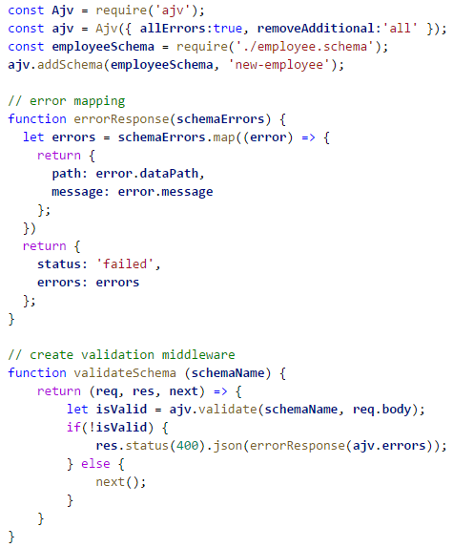

AJV

Slide 6
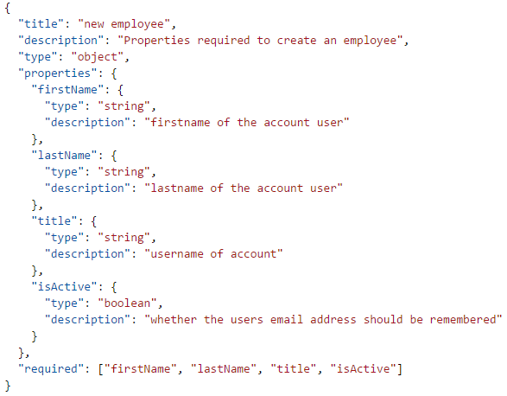
JSON SCHEMA

Slide 7
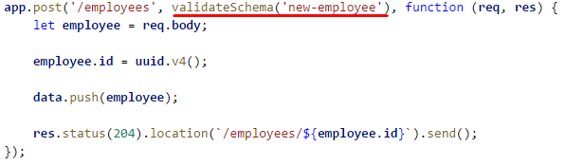
APPLY SCHEMA

Slide 8
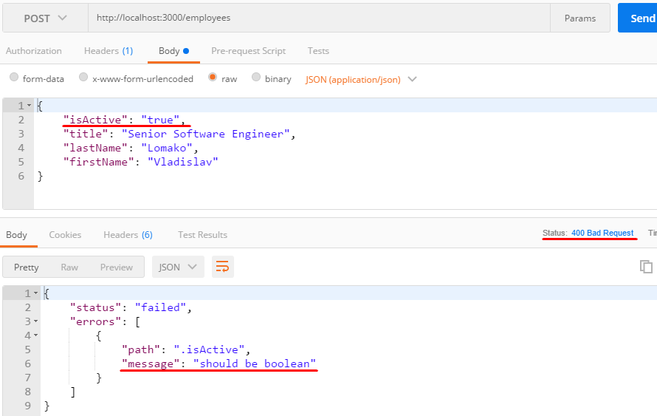
AJV RESPONSE

Slide 9
AUTHENTICATION
Passport.js
JSON Web Tokens

Slide 10

WHAT IS PASSPORT
Authentication middleware for Node.js
Extremely flexible and modular
Can be unobtrusively used with any Express application
500+ strategies to choose from

Slide 11
GET IT WORK
Require passport module and initialize it
Configure passport with at least one Strategy
Specifying a route for authentication
Protect routes

Slide 12
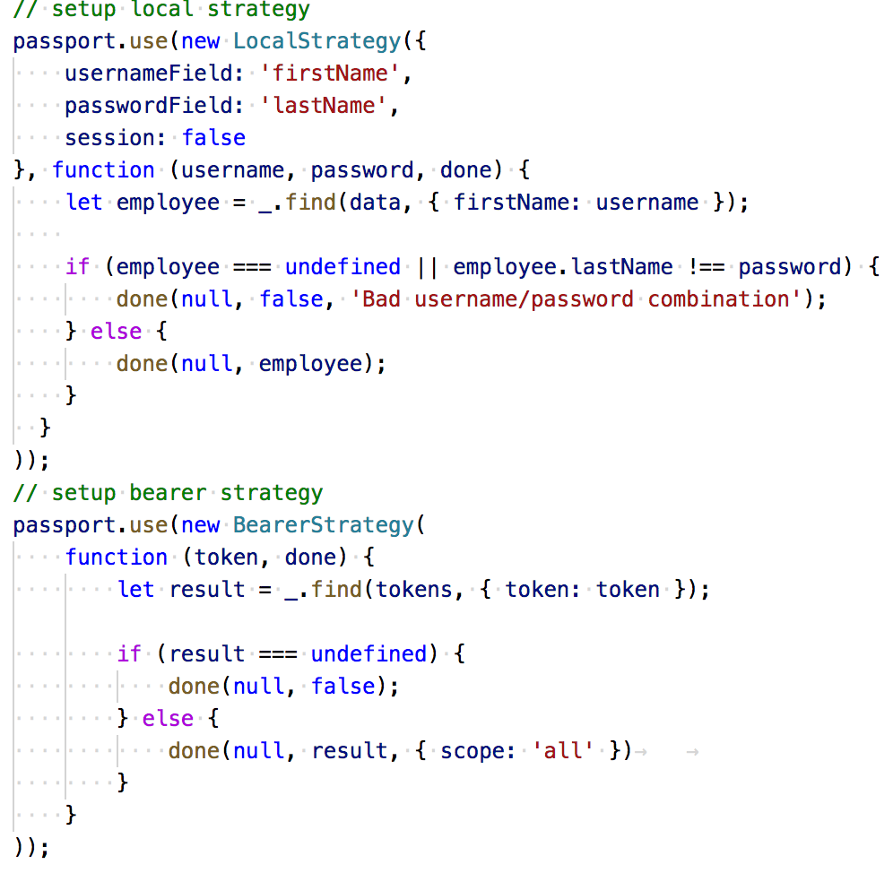
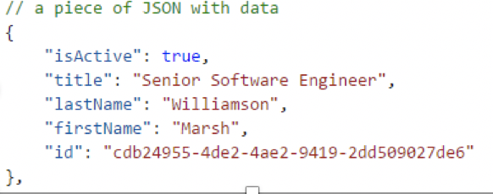
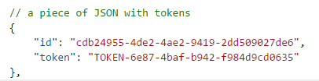
SETUP LOCAL STRATEGY

Slide 13
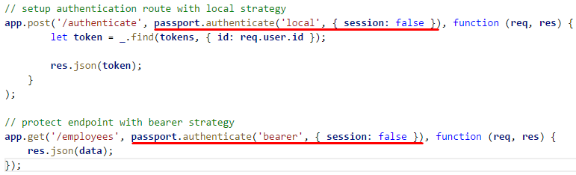
CONNECT WITH EXPRESS

Slide 14
REQUESTS
POST request to the authentication route with data in body As a result get JSON with ID and TOKEN in response
GET request to the protected authentication with bearer token

Slide 15
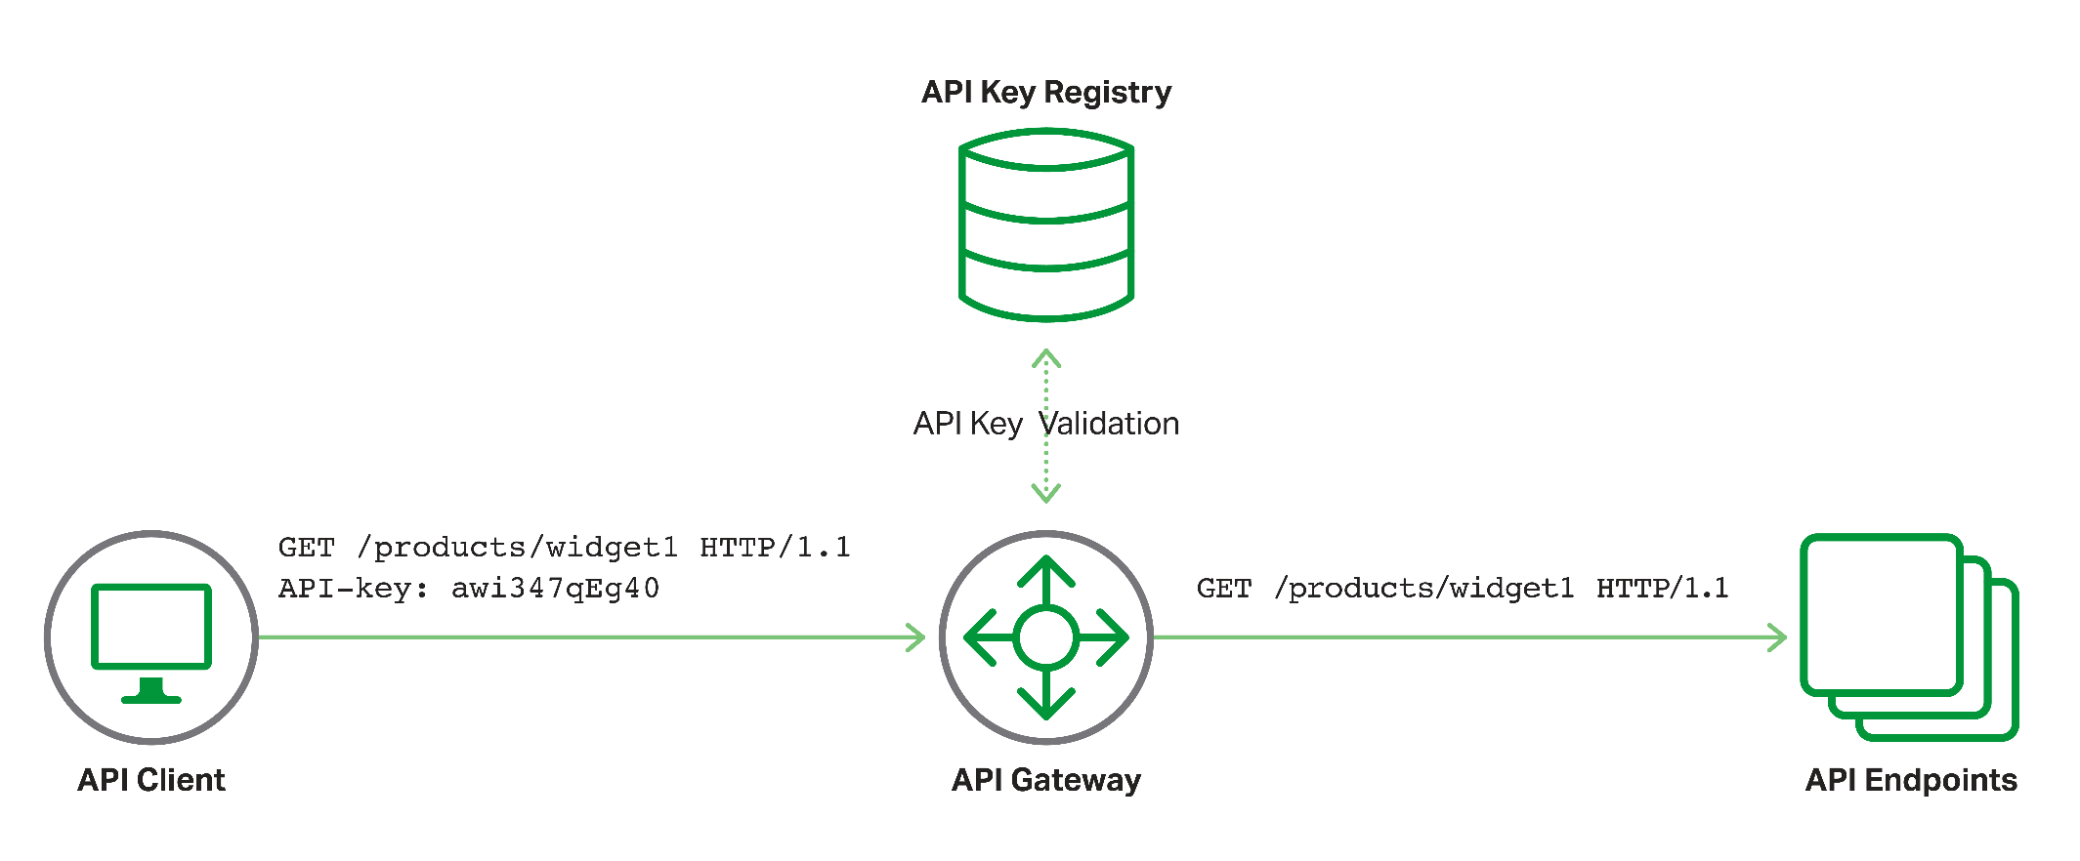
REGULAR TOKEN AUTH

Slide 16
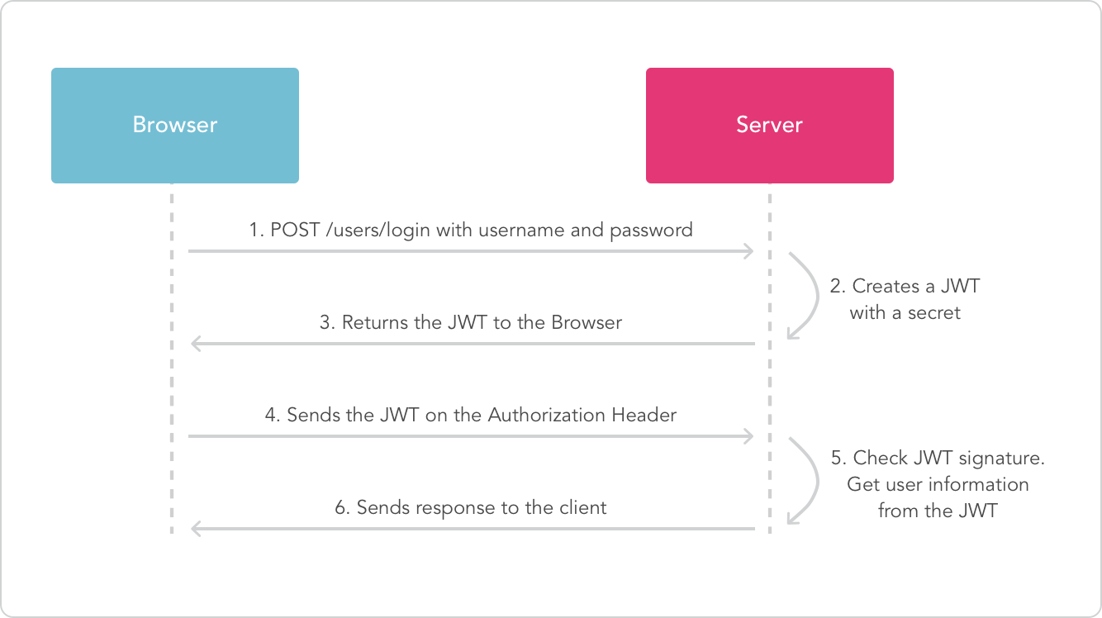
HOW DOES IT WORK

Slide 17
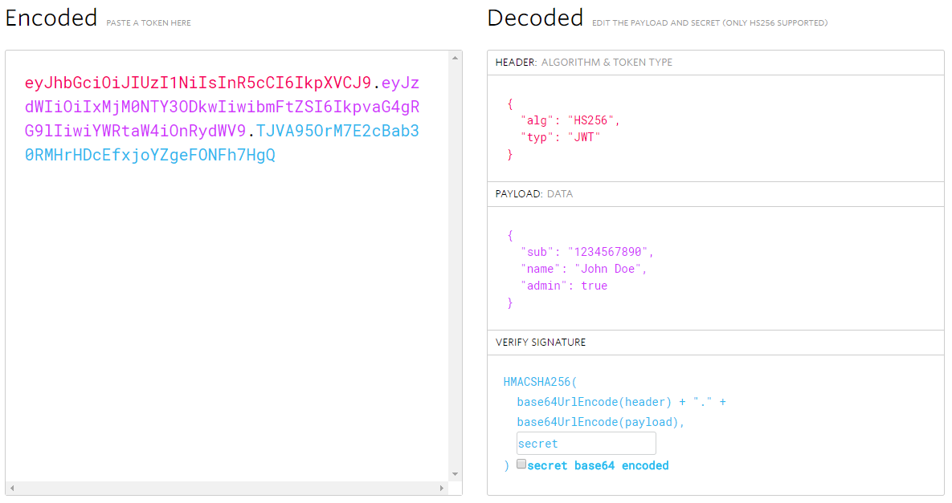
COMPACT AND SELF-CONTAINED
* https://jwt.io/

Slide 18
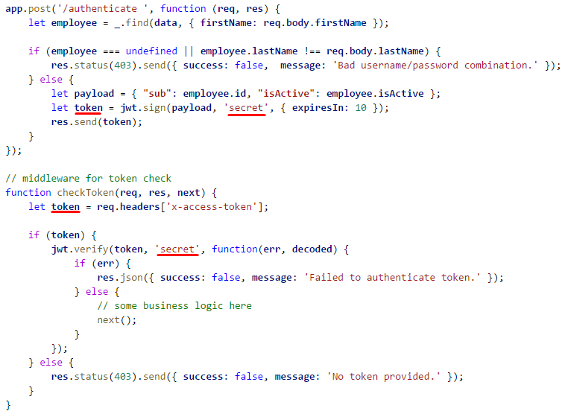
SETUP JWT

Slide 19
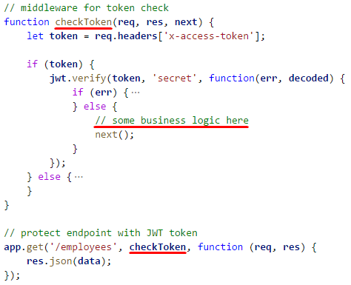
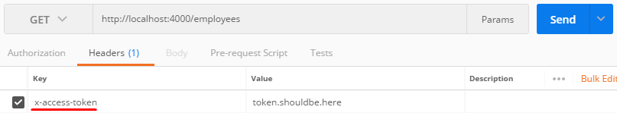
PROTECT ENDPOINT WITH JWT

Slide 20
JWT PROS AND CONS
No server-side storage
Easy to use (a lot of libs)
Can be used across services
One key rules all
Can't be revoked permanently (in general)

Slide 21
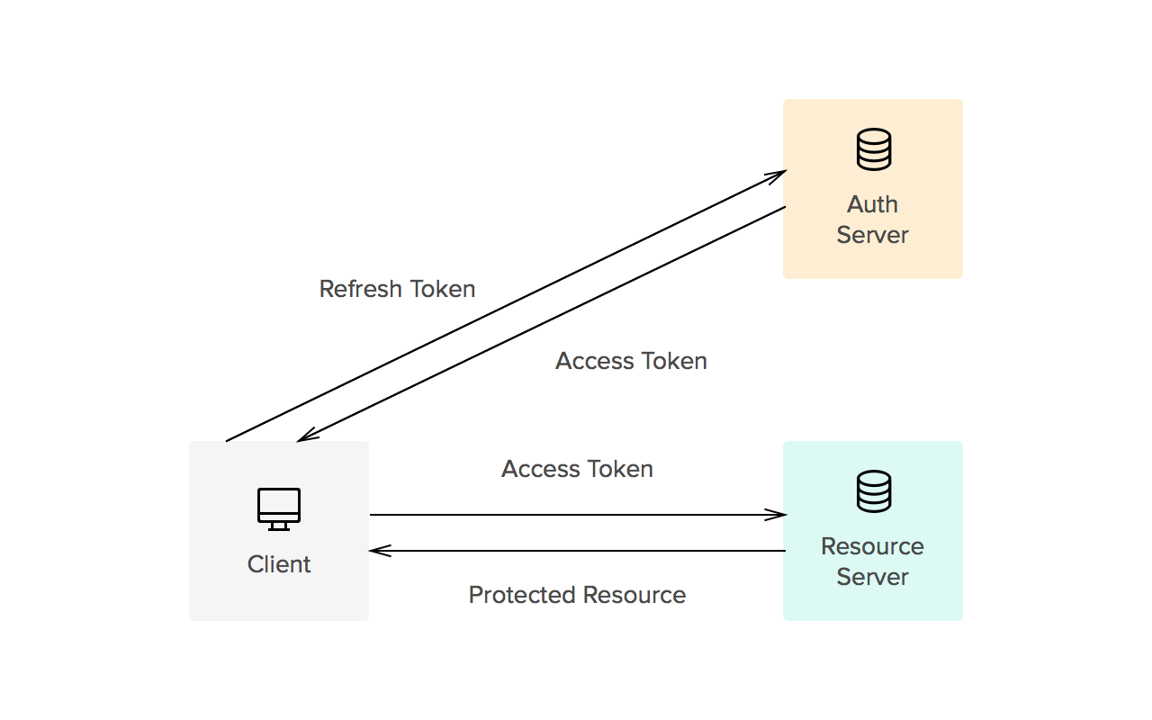

ACCESS TOKEN AND REFRESH TOKEN

Slide 22
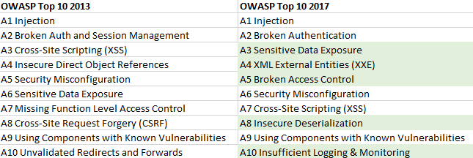
OWASP TOP 10

Slide 23
NODE SECURITY
Static analysis
Sensitive data on the client side
Running process with superuser rights
Vulnerabilities in dependencies
Known vulnerabilities in your code
Error logging

Slide 24
API SECURITY
HTTPS
Access Control
Restrict HTTP methods
Input validation
Error handling
Audit logs
Security headers
Sensitive information in HTTP requests

Slide 25


HELMET
Hide Powered-By
HSTS
No Cache
.. and more

Slide 26
USEFUL LINKS
Design by contract
JSON Schema
Custom Passport strategy
node-jsonwebtoken
Open Web Application Security Project (OWASP)
REST API Security Cheat Sheet
Express Production Security Best Practices
Retire.js, Node Security Platform, Snyk
Helmet

Slide 27
NODE.JS GLOBAL
Middleware. Frameworks BY Vladislav Lomako
Mohamadali ganji

